Slide 1



project BV1
View in Power BI
Last data refresh:
4/16/2024 5:29:48 AM UTC
Downloaded at:
4/17/2024 1:20:31 PM UTC

Slide 2
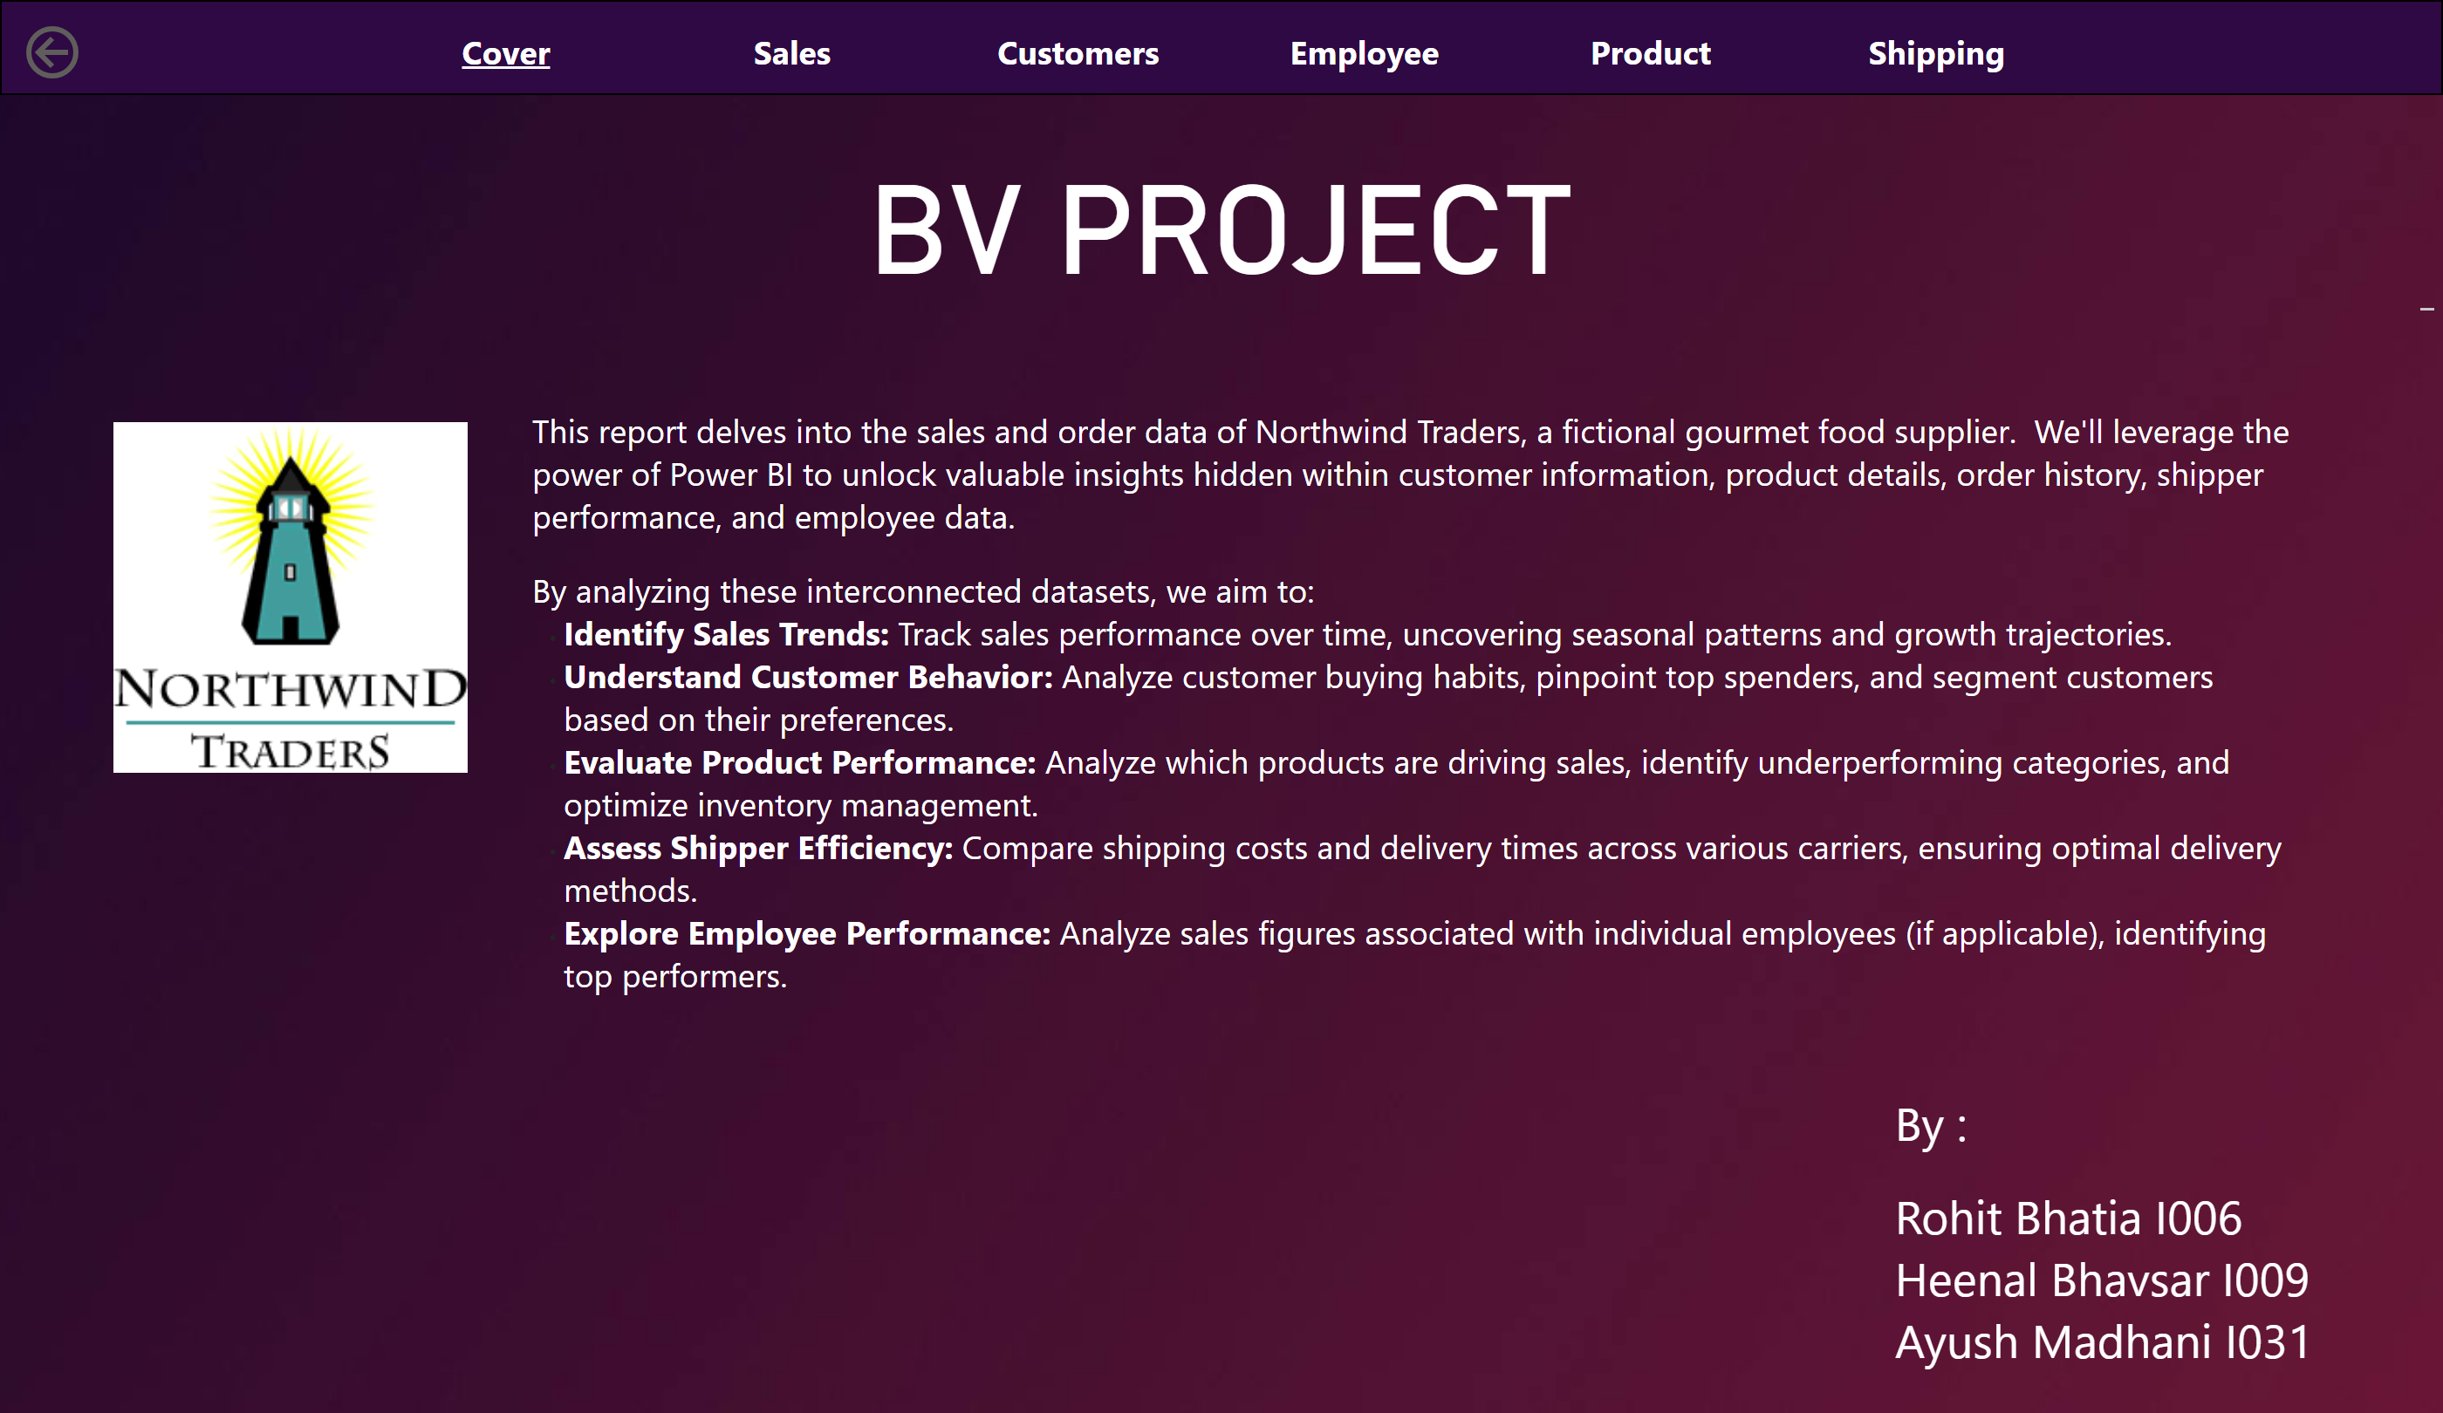
Cover
Notes:
actionButton
No alt text provided
pageNavigator
No alt text provided
shape
No alt text provided
BV PROJECT
No alt text provided
textbox
No alt text provided
image
No alt text provided
textbox
No alt text provided

Slide 3
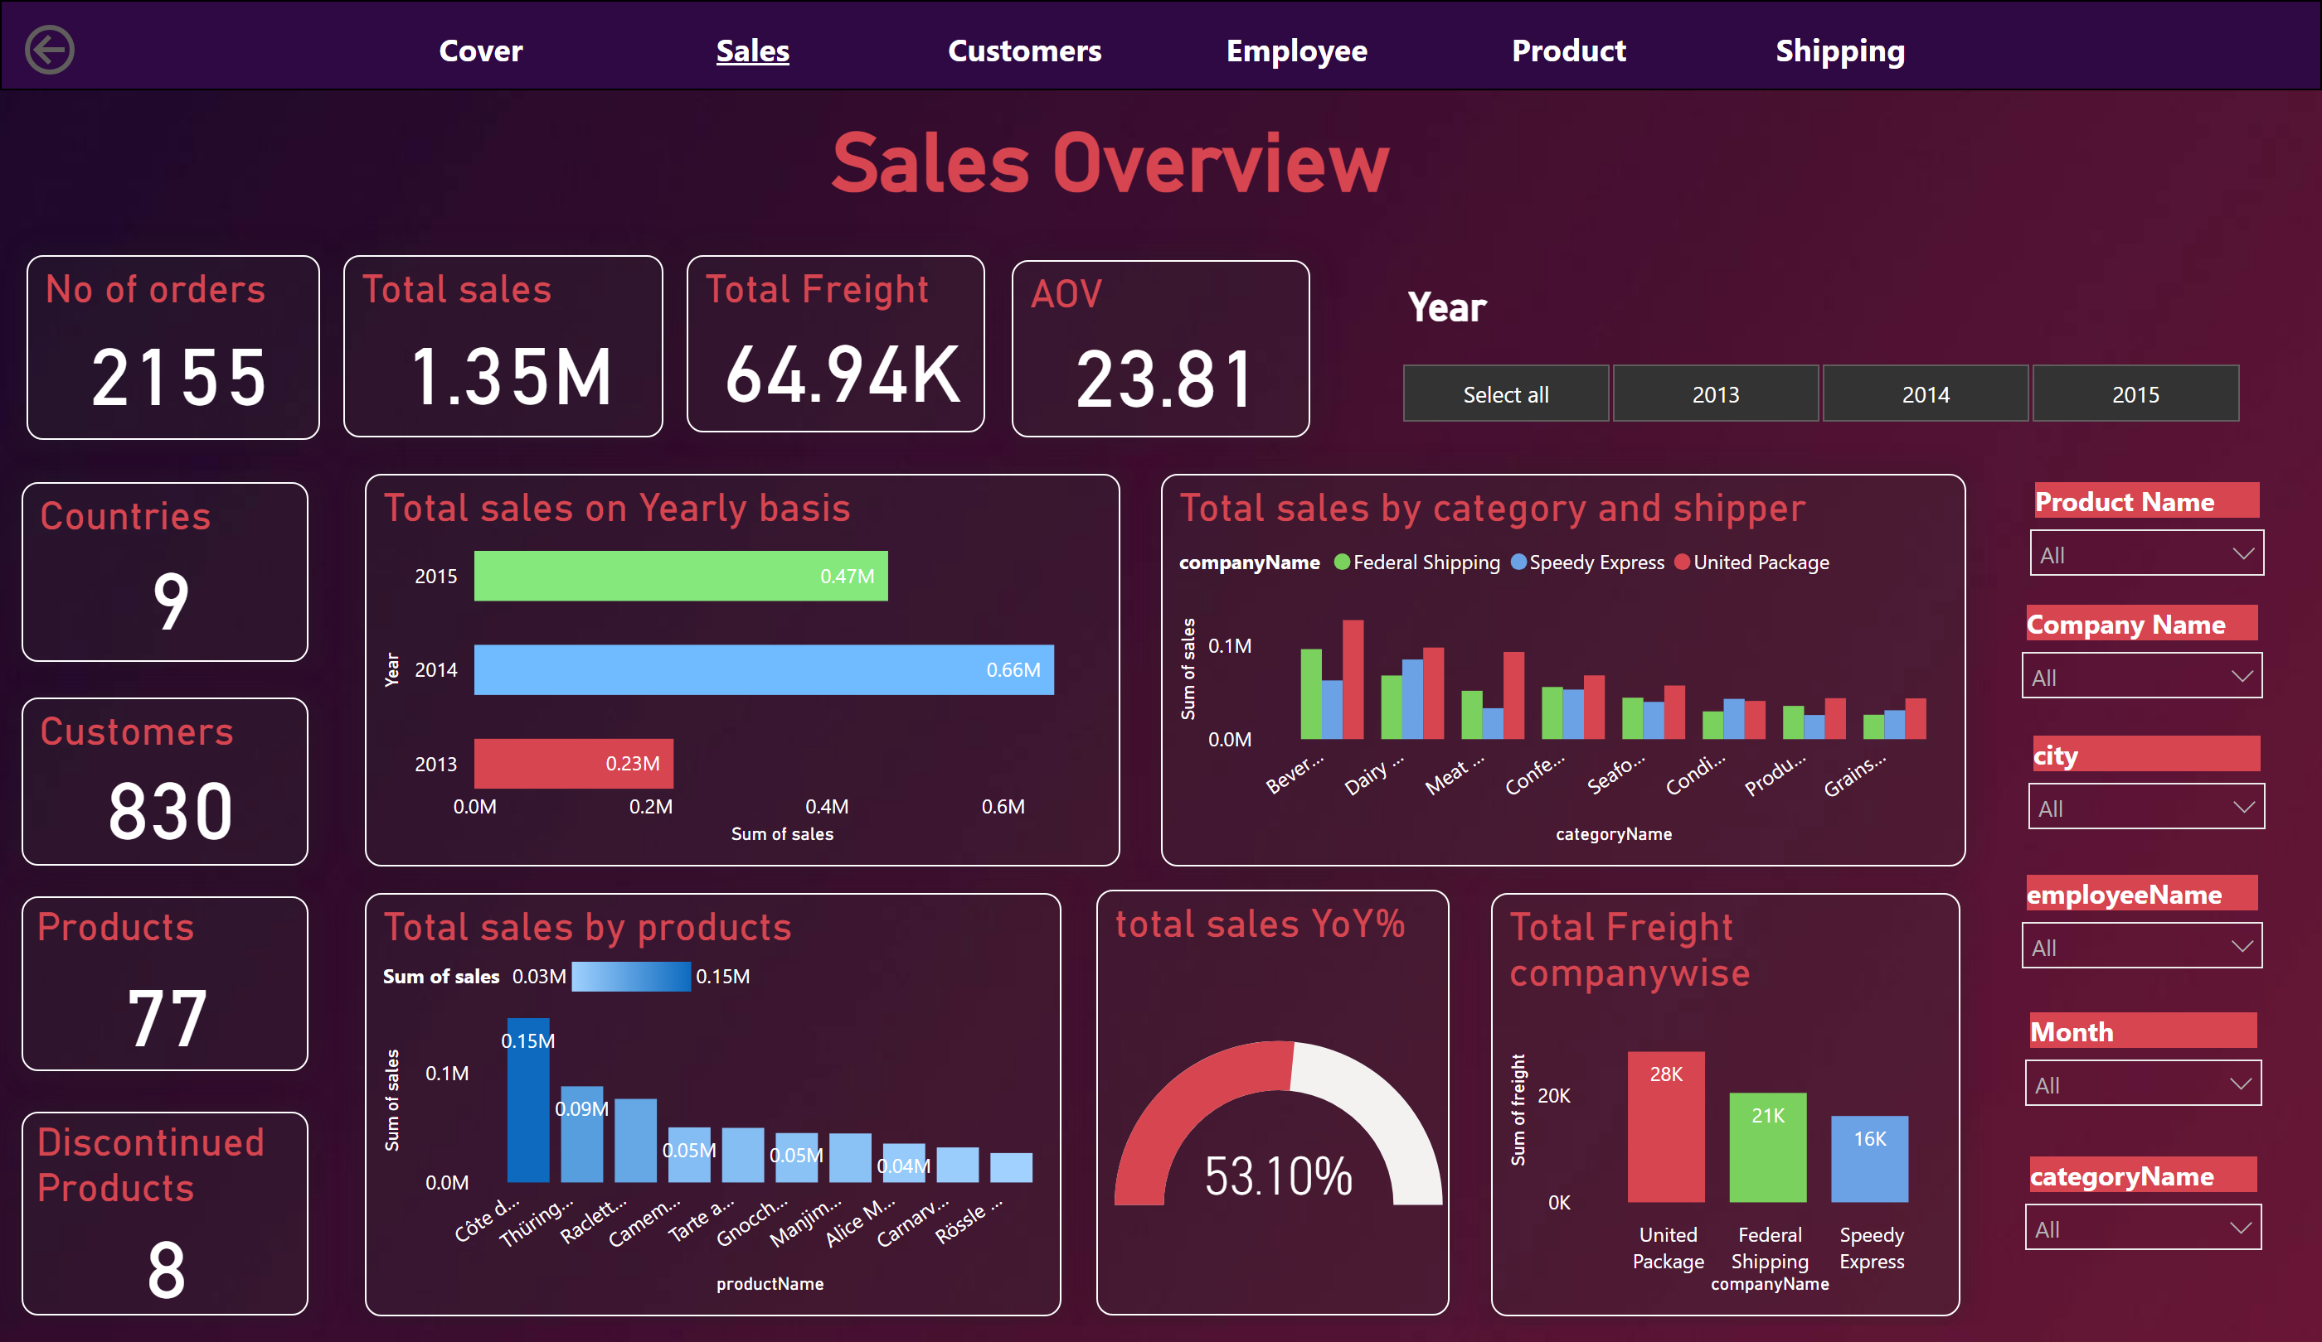
Sales
Notes:
Total sales on Yearly basis
No alt text provided
Total sales by products
No alt text provided
Total sales by category and shipper
No alt text provided
Total Freight companywise
No alt text provided
gauge
No alt text provided
pageNavigator
No alt text provided
Total sales
No alt text provided
Total Freight
No alt text provided
slicer
No alt text provided
slicer
No alt text provided
slicer
No alt text provided
slicer
No alt text provided
slicer
No alt text provided
slicer
No alt text provided
slicer
No alt text provided
No of orders
No alt text provided
Countries
No alt text provided
Customers
No alt text provided
Products
No alt text provided
Discontinued Products
No alt text provided
shape
No alt text provided
Sales Overview
No alt text provided
Year
No alt text provided
AOV
No alt text provided
actionButton
No alt text provided

Slide 4
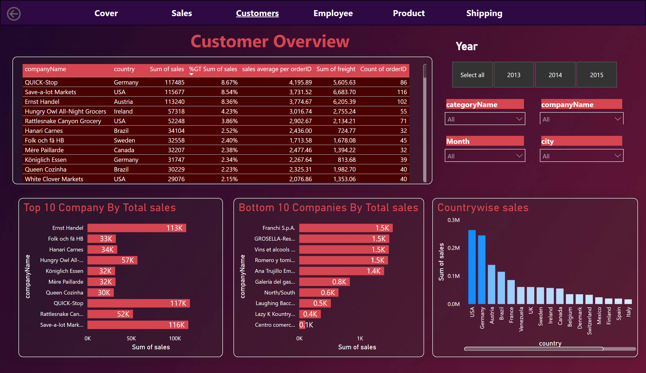
Customers
Notes:
Countrywise sales
No alt text provided
Top 10 Company By Total sales
No alt text provided
Bottom 10 Companies By Total sales
No alt text provided
tableEx
No alt text provided
slicer
No alt text provided
slicer
No alt text provided
slicer
No alt text provided
textbox
No alt text provided
pageNavigator
No alt text provided
shape
No alt text provided
Year
No alt text provided
slicer
No alt text provided
slicer
No alt text provided
actionButton
No alt text provided

Slide 5
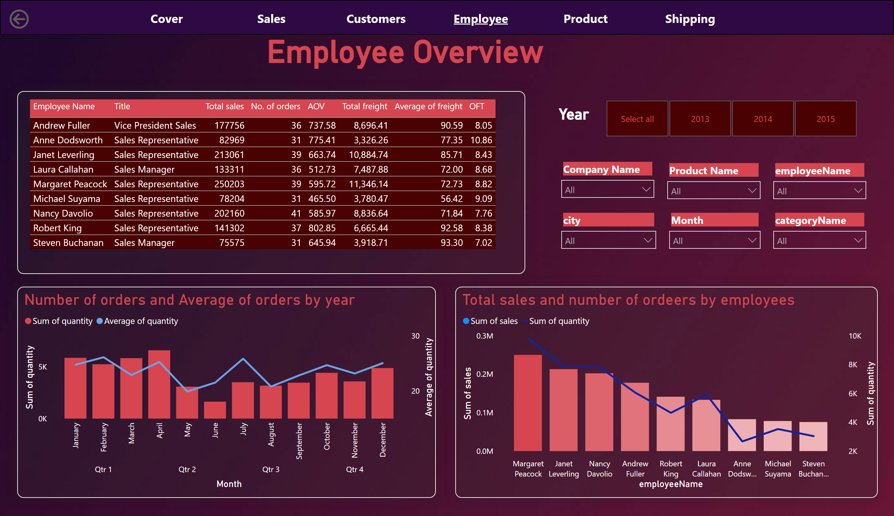
Employee
Notes:
Number of orders and Average of orders by year
No alt text provided
pageNavigator
No alt text provided
shape
No alt text provided
slicer
No alt text provided
Employee Overview
No alt text provided
Total sales and number of ordeers by employees
No alt text provided
tableEx
No alt text provided
slicer
No alt text provided
slicer
No alt text provided
slicer
No alt text provided
slicer
No alt text provided
Year
No alt text provided
slicer
No alt text provided
slicer
No alt text provided
actionButton
No alt text provided

Slide 6
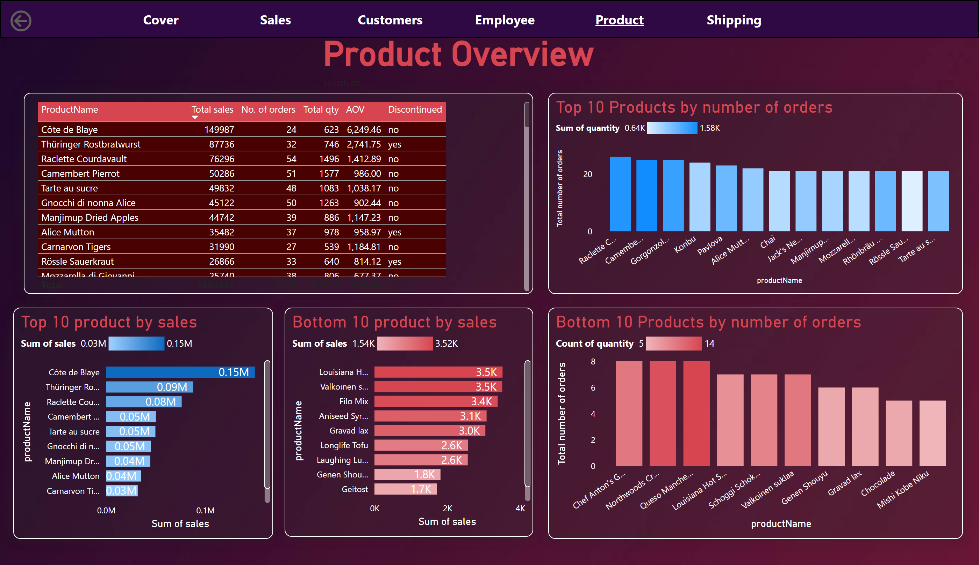
Product
Notes:
Top 10 Products by number of orders
No alt text provided
pageNavigator
No alt text provided
shape
No alt text provided
Product Overview
No alt text provided
Bottom 10 Products by number of orders
No alt text provided
Top 10 product by sales
No alt text provided
Bottom 10 product by sales
No alt text provided
tableEx
No alt text provided
actionButton
No alt text provided

Slide 7
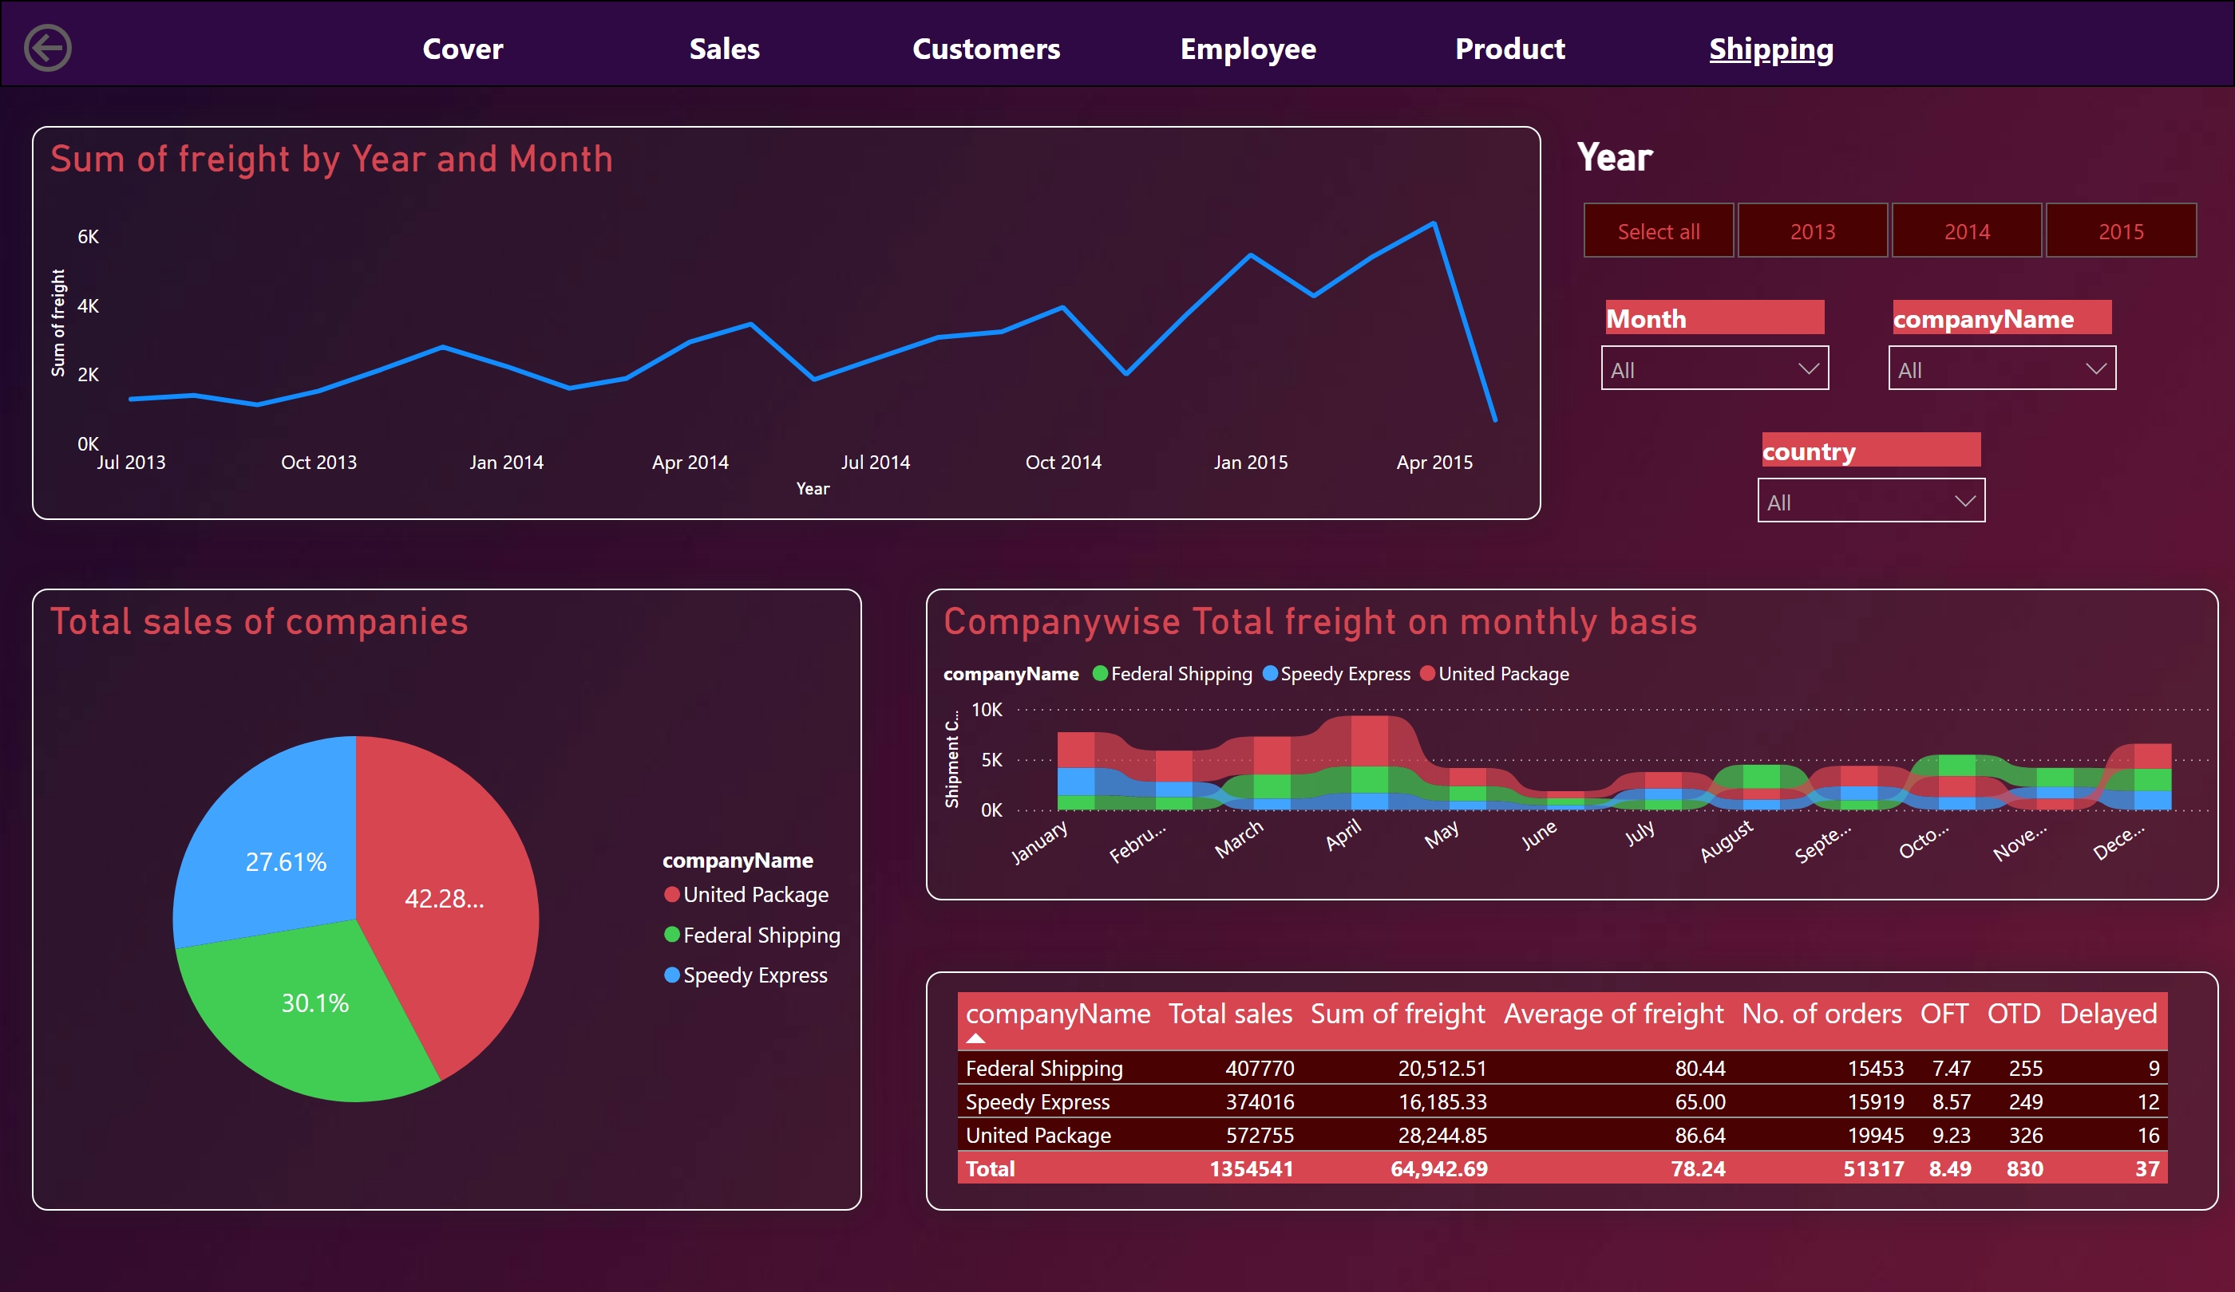
Shipping
Notes:
actionButton
No alt text provided
pageNavigator
No alt text provided
shape
No alt text provided
stackedAreaChart
No alt text provided
slicer
No alt text provided
slicer
No alt text provided
Year
No alt text provided
slicer
No alt text provided
slicer
No alt text provided
Total sales of companies
No alt text provided
Companywise Total freight on monthly basis
No alt text provided
tableEx
No alt text provided

